Slide 1

The Eye
GTHBY Human Biology

Slide 2
Review
Which structure of the ear is responsible for
Converting vibrations to nerve impulses
Passing vibrations from the eardrum to the cochlea
Allowing pressure regulation inside the middle ear
Transmitting nerve impulses to the brain
Sensing balance and position of the head

Slide 3
Review: Outer, middle or inner ear?
Pinna
Auditory nerve
Eustachian tube
Ossicles
Oval window
Eardrum
Auditory canal
Round window
Cochlea
Semicircular canal

Slide 4
Review
3. What type of neuron would you find in the cochlea?
4. Draw a picture of this type of neuron.
5. Which part of the brain would the nerve signals from the ears go to? Why?

Slide 5
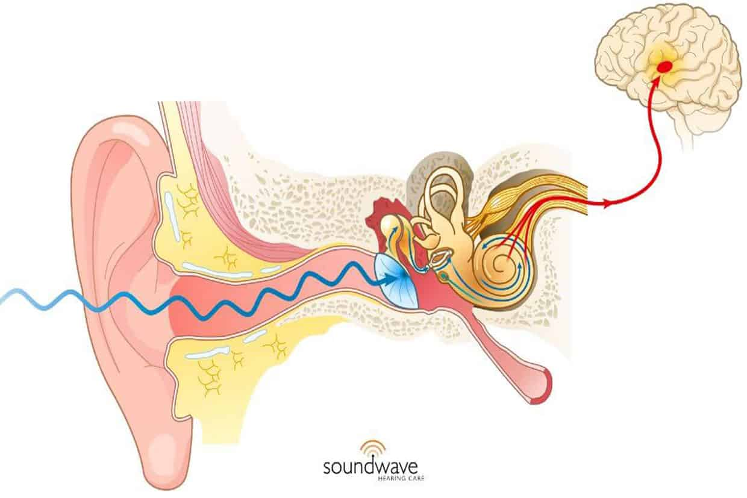
Temporal lobe

Slide 6
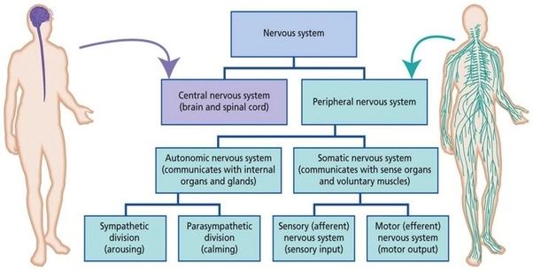

Slide 7
Learning Intentions
Structure of the eye and the stimuli they respond to

Slide 8
Success Criteria
Label an anatomical diagram of an eye
Describe the eye/retina as a sensory organ
Describe the optic nerve as sensory, afferent and somatic parts of the PNS
Explain how light and colour relate to nerve impulses.

Slide 9
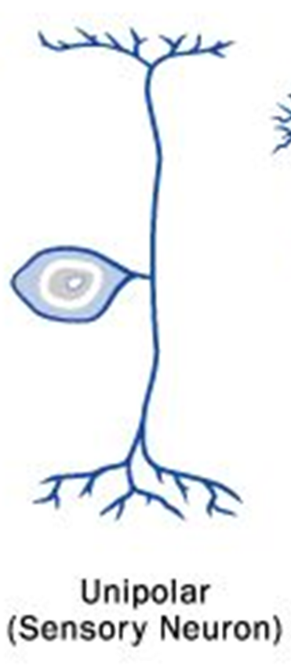
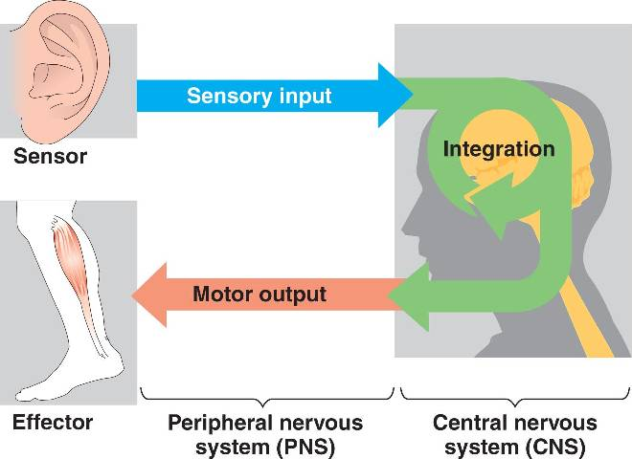
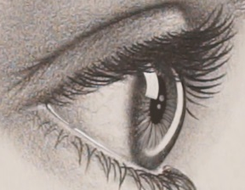
Primary Functions
Sensory (afferent) neurons
Interneurons
Motor (efferent) neurons

Slide 10
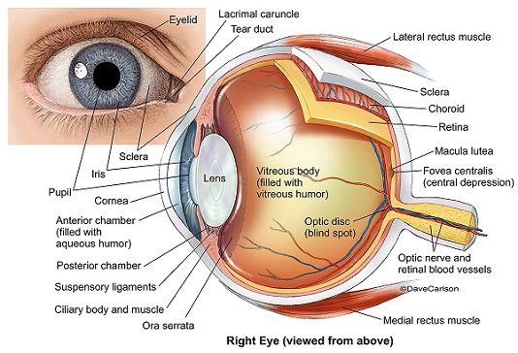

Slide 11
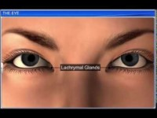

Slide 12
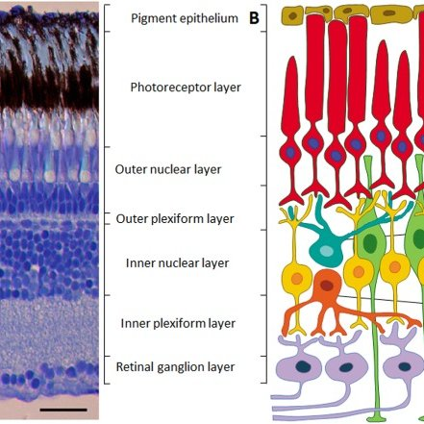

Slide 13
Success Criteria
Label an anatomical diagram of an eye
Describe the eye/retina as a sensory organ
Describe the optic nerve as sensory, afferent and somatic parts of the PNS
Explain how light and colour relate to nerve impulses.

